Slide 1
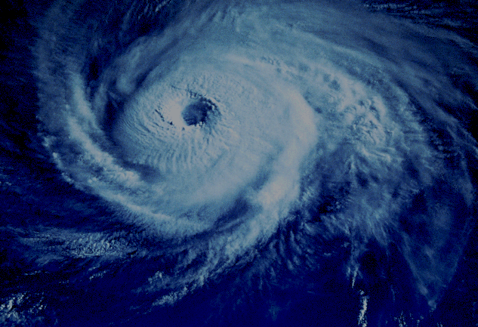
Typhoons

Slide 2
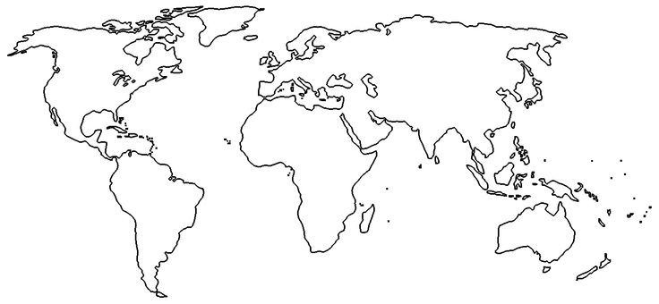
Typhoons
In the box, write a recipe for the formation of a typhoon. You will be presented with information and can research on your laptop. Make sure your recipe includes as much detail as possible and all of the ingredients in the right order.
Typhoon Recipe
On the map above, mark on the locations you would expect to find Typhoons, Hurricanes and Cyclones.
In the space below, explain the difference between these 3 types of storm system (Give detailed geographical explanations)
Typhoon season in the Northern hemisphere is….
Typhoon season in the Southern hemisphere is….
Finished your recipe? Test your knowledge on the website below

Slide 3
Typhoons
Fact: A Typhoon is called a Super-typhoon when it has winds of over 240kmh for over one minute.
Fact: Typhoons can be up to 1000km wide
Windspeed
Research and write down the wind speeds needed for each of these different categories
Tropical Depression
Tropical Storm
Tropical Cyclone
What does a typhoon look like? Draw a diagram of the inside of a typhoon cloud. You should add labels and make sure your diagram shows what is happening inside
How are typhoons named?
Fact 1:
Fact 2:
Fact 3:

Slide 4
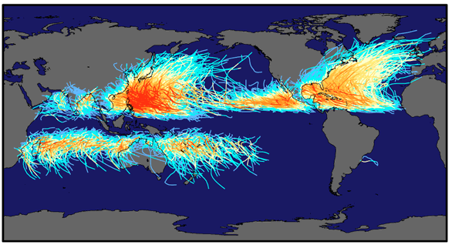
Typhoons, Cyclones, Hurricanes
What’s the difference?
Typhoons
Hurricanes
Cyclones

Slide 6
Where, when and why do they develop?
Form over the ocean between May and November (Northern Hemisphere)
Between November and May (Southern Hemisphere)
Sea surface must be a minimum of 26°C
Hot sea surface warms air in contact with it, large amounts of water vapour evaporates
Moisture is important for fueling the growth of the storm

Slide 7
Heated moist air expands, becomes lighter and rises
Form between tropics between 5° and 20° North and South
Do not form nearer the equator because the effect of Earth’s rotation is needed to make the rising air spin
Do not form in higher latitudes as water is not warm enough
Most Tropical Storms form toward the west side of oceans (Mexico’s west coast an exception)

Slide 8
Global Circulation

Slide 10
Depressions, storms & Cyclones
Tropical depressions (winds at 60km/h or less)
Tropical storms (winds 61-120km/h)
Tropical cyclone (winds over 120km/h)

Slide 11
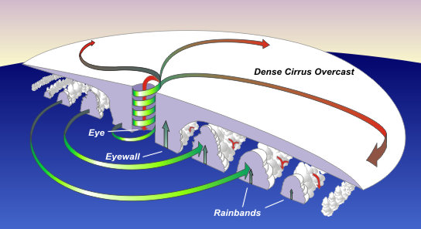
How Tropical Cyclones Develop

Slide 12
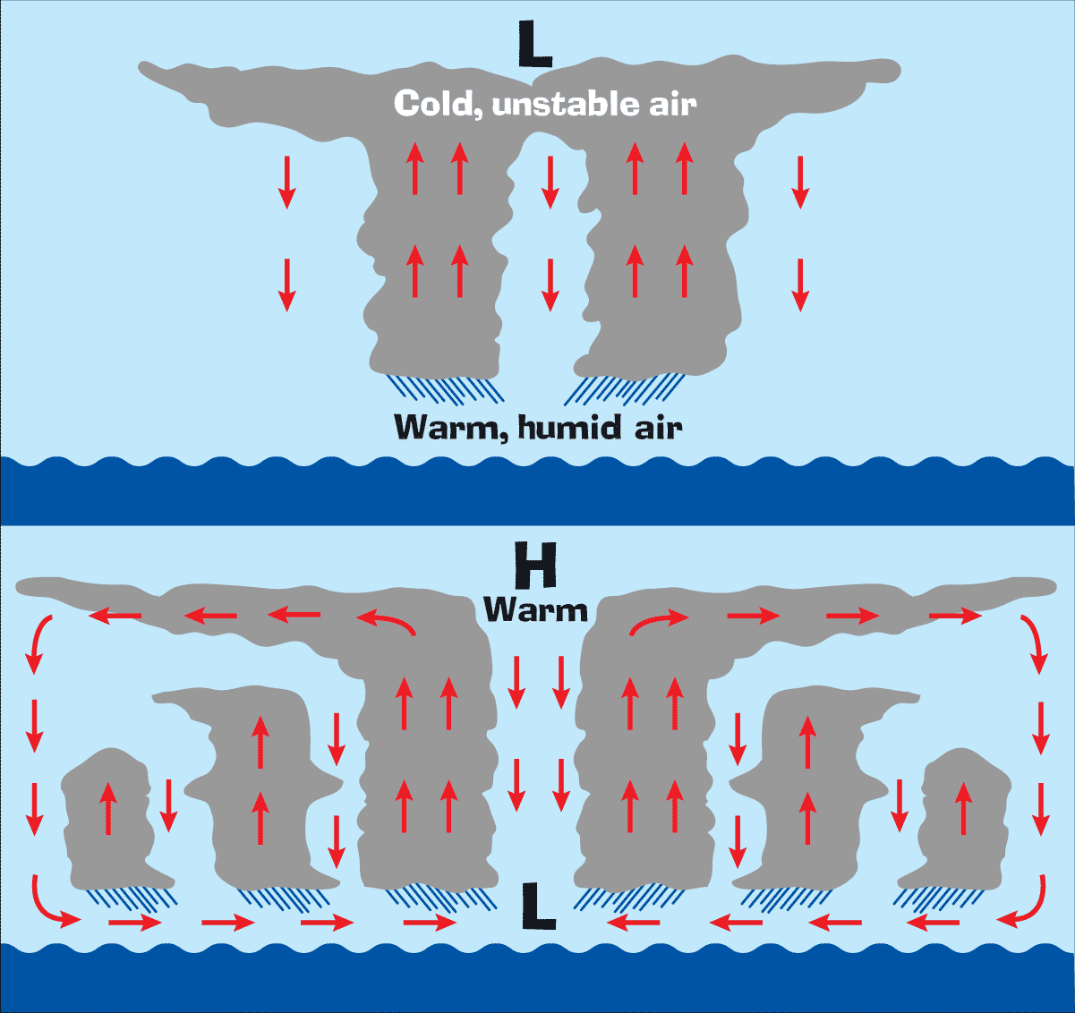

Slide 13
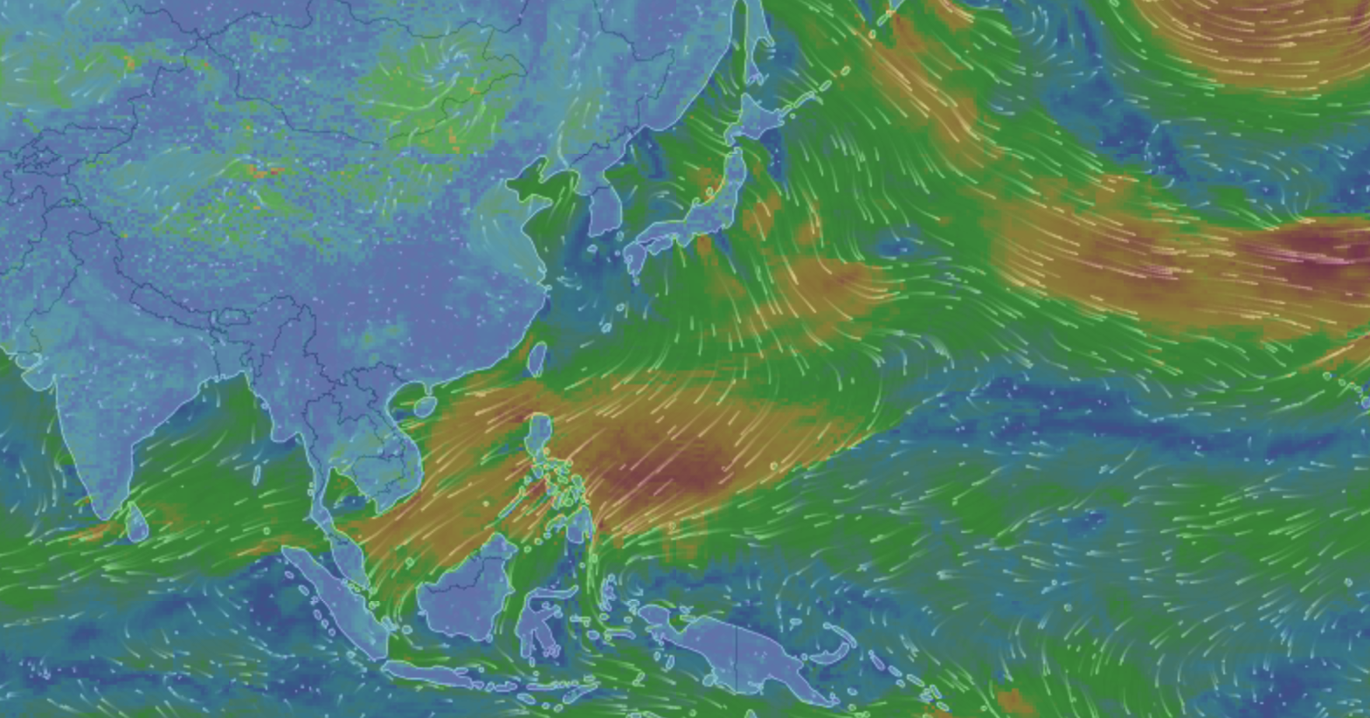
Windyty Challenge – Can you find a Typhoon?
Look on Windyty
Notes:
I'm doing an activity with mine called "Find a Typhoon" in the next lesson using my favourite website
https://www.windytv.com
If they go on the website they have to screen shot an area where they think there is a typhoon/cyclone/hurricane and then annotate it using evidence from the website. They can check sea temperature, wind patterns and strength, wave heights, pressure etc etc. They should look at as many different data overlays as possible and use that as evidence in annotations on their screenshot (They can use ppt or Word or anything they like - they could also put in multiple screenshots of the same area, although this might get too messy) Extension should be easy for this because there are so many data possibilities. Simple responders could just focus on circular patterns in warm sea areas.

