Slide 1
What are the POSITIVE sides to Globalisation?
brainstorm in groups for 2 minutes
What are the negative sides to Globalisation?
We’re going to watch 2 video’s to explore this question
The Economic Hitmen
There you go!

Slide 2
Pollution, Society
and Globalisation
What is the relationship between Pollution and
Globalisation?
or
What is the relationship between Globalisation and Society
Answer one of these questions on a maximum
of 1 side of A4. Use a format of your choosing
e.g. Poster, Essay, Information leaflet, Infographic

Slide 3
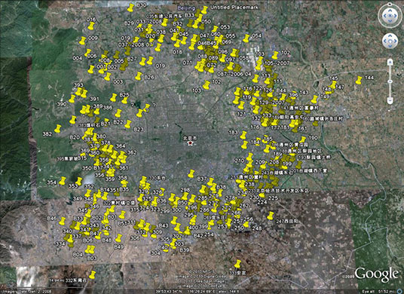
Brain
Teaser
What are the yellow pins showing?

Slide 4
If you’re thinking that….
Globalisation is
a Rubbish topic
You are a little bit correct!

Slide 5
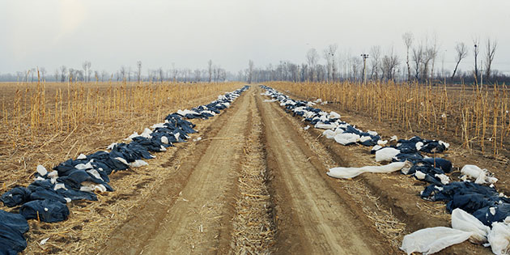
Xiaotangshan town, Changping district Human excrement collected from planes, trains, and long-distance buses is dumped here
in big plastic bags. Because there is no convenient way to get rid of the waste - aside
from the small quantity that farmers take for fertilisers - large quantities are being
dumped in landfill along with the rest of the garbage

Slide 6
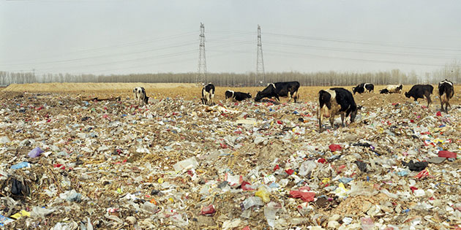
Xiaotangshan town, Changping district This landfill is right near a river bank, where waters have been polluted with the
decomposing toxins from the waste. Dairy cows from a nearby farm come to the river
daily to drink, and root among the trash for things to eat

Slide 7
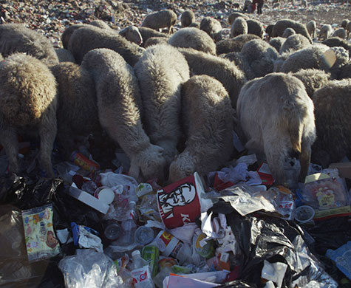
Tuanli community of Songzhuang town, Tongzhou district Over 200 sheep engorge
themselves on mouthfuls of trash, heightening their risk of disease and infection. Toxic
smoke permeates the air from small fires that burn throughout the Tuanli landfill site

Slide 8
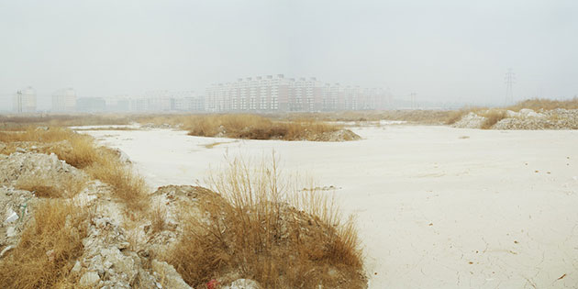
Beijing economic-technological development, eastern area A considerable amount of construction waste has been left over from large-scale
development projects. Pictured here is quicklime waste from the construction; the caustic
material has seeped deep into the surrounding sources of ground water

Slide 9
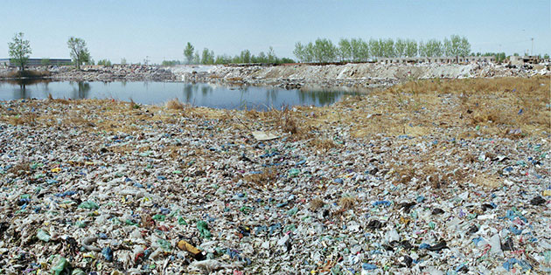
National environmental protection industrial park This park is still under construction but already completely covered with plastic bags

Slide 10
Why is waste disposal such a
problem in Beijing?
China’s rapidly growing economy over the last 20 years
Has lead to increasing wealth amongst citizens
and a boom in consumer spending
and a rapid increase in generated
waste products
an increase in land value
Waste disposal and
processing infrastructure
can’t keep up
means an increase in the
cost of landfill

Slide 11
Waste and pollution in China
WAW!!!!
Word Association Wall
Write the title and then write down as many words and phrases that come to mind when you think about it. 2 minutes!

Slide 12
What happens to waste in Hong Kong?
1 minute group brainstorm

Slide 13
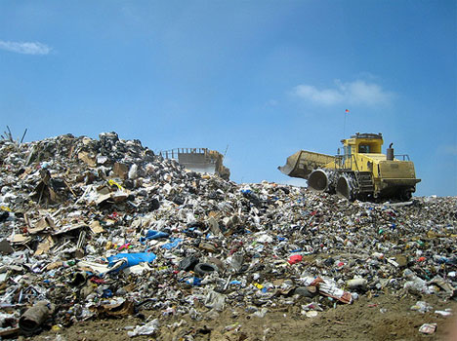

Slide 14
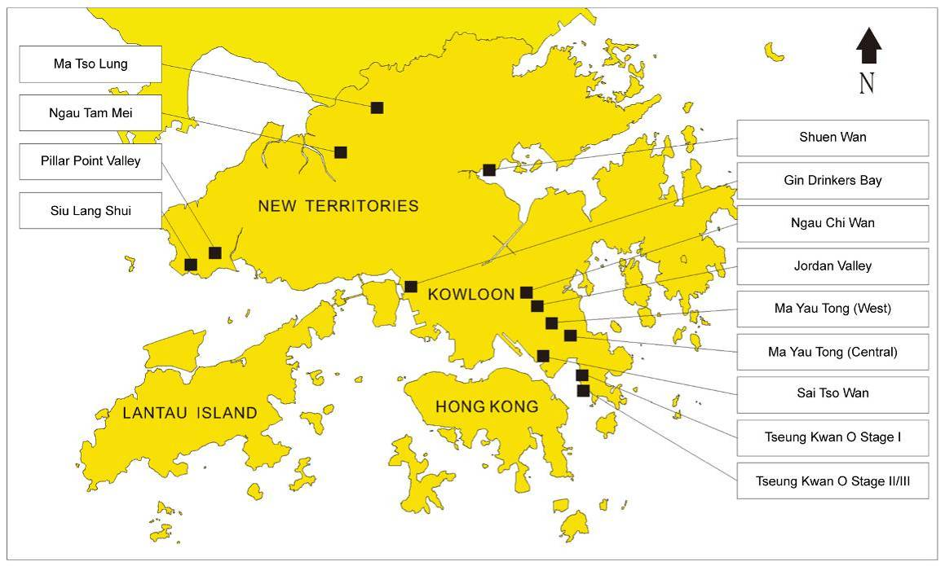
Solid waste disposal sites

Slide 15
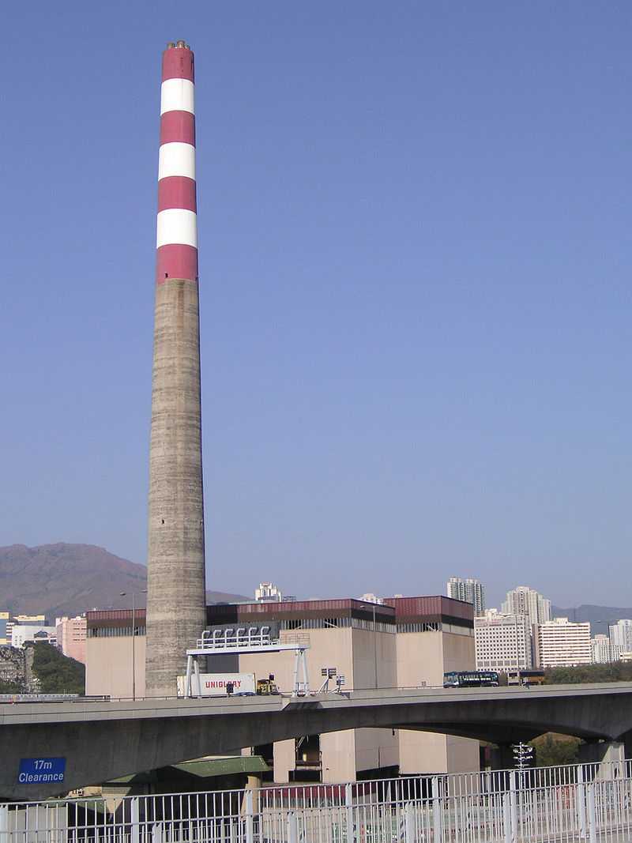
Incinerators
1989 – Government decided to shut down the 4 existing sites over air pollution concerns. The last site closed in 1997
The decision was reversed in 2008 and Hong Kong is planning to build new waste incinerators

Slide 16
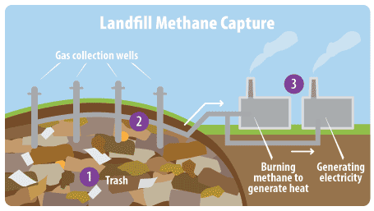

Slide 17
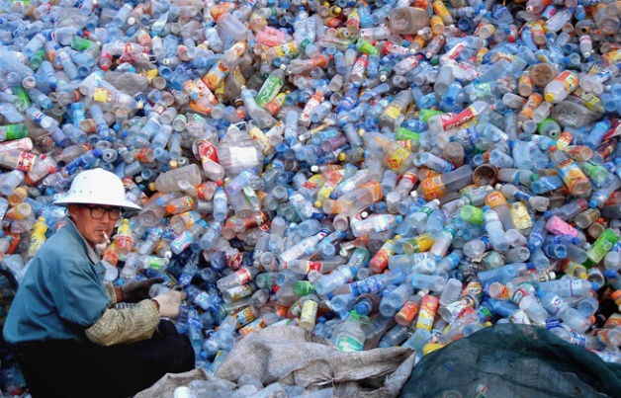
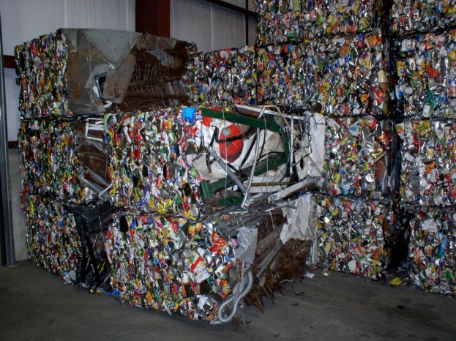
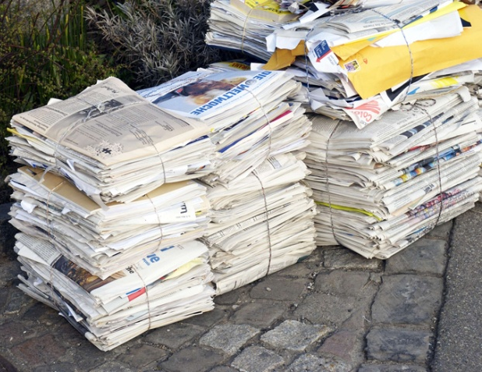

Slide 18
What does recycling mean?
…to the World?
Do you recycle?
Do Europeans recycle?
Do North Americans recycle?
Is recycling pleasant work?
Is it well paid work?
Who actually recycles?

Slide 19
Rich Countries buy lots of disposable goods and create lots of waste
Poor countries make lots of disposable goods
Ships sail back to poor countries full of waste
Rich countries collect a lot of waste products for recycling
Poor countries ship their goods over to rich countries
Hmmm…. What could we do?
Ships arrive in rich countries and empty their goods….
Empty ships will soon be heading back to poor country’s
Poor countries deal with rich countries’ waste

Slide 20
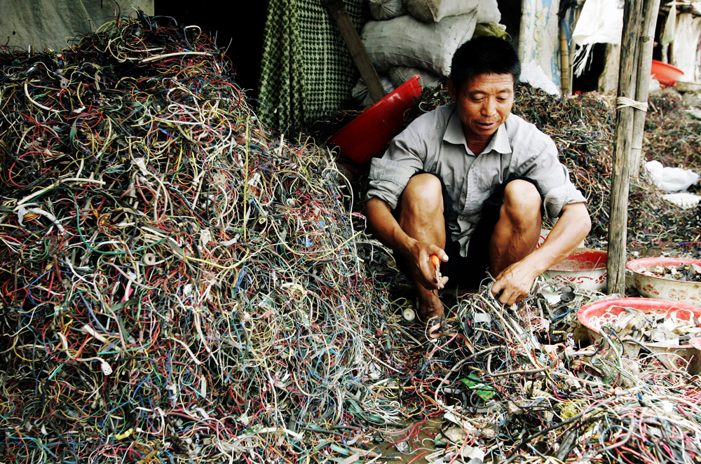
What happens to PC’s when they die?

Slide 21
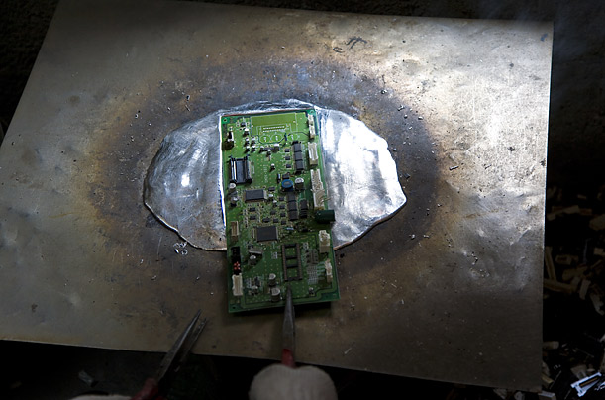
Extraction. The ewaste is mined for the lead, gold, copper and other metals that are found in the circuit boards, wiring, chips and other parts of electronic devices. In this photo, a worker heats a computer board on a steel surface to remove the computer chips soldered into it.

Slide 22
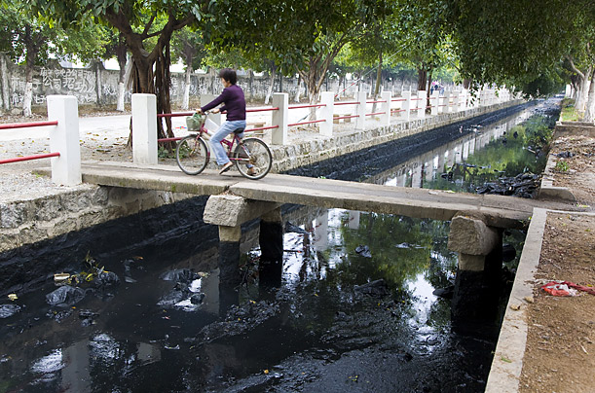
Black Water Much of the waste from the work, particularly the ash from the burning of coal, is dumped into city's streams and canals, poisoning the wells and groundwater.

Slide 23
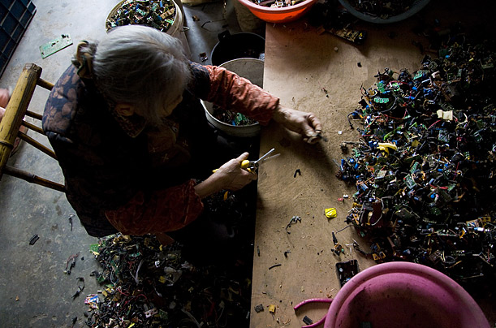
Details. Guiyu — and places like it in India and Africa — fluorish because it is far cheaper to break down e-waste there than it is in the developing world, where companies must follow strict guidelines.

Slide 24
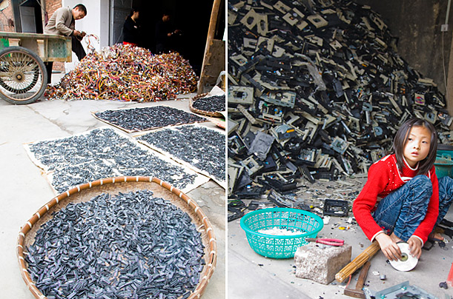
Workshops Health reports from the region say that Guiyu's children suffer from an extremely high rate of lead poisoning.

Slide 25
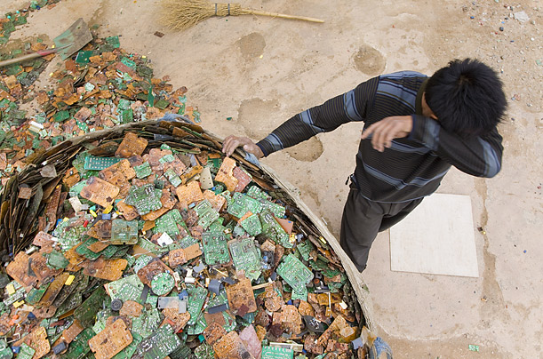
Hard Work According to reports from nearby Shantou University, Guiyu has the highest level of cancer-causing dioxins in the world and an elevated rate of miscarriages.

Slide 26
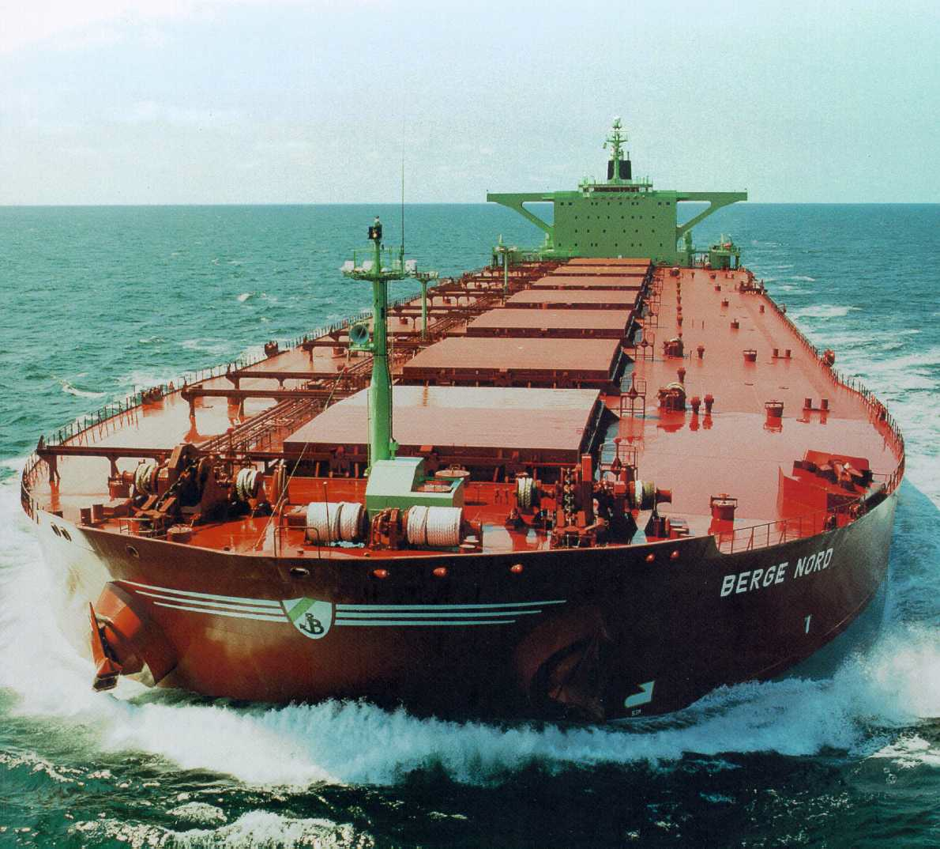
What happens to Oil tankers
when they die?
https://www.youtube.com/watch?v=v7VkF8rWGtU

Slide 27
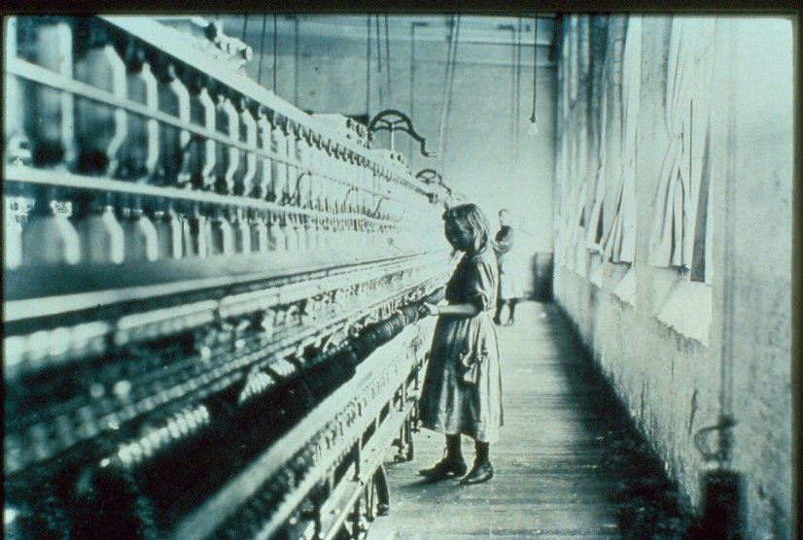
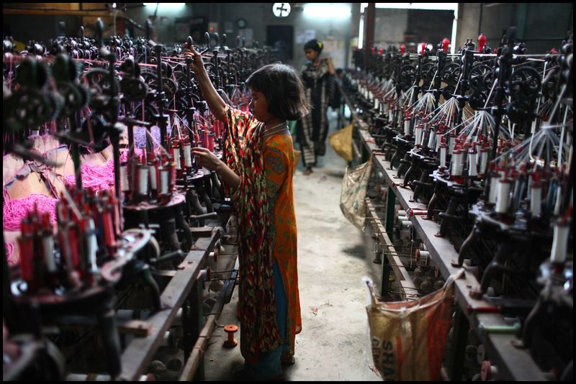
Can “LEDC’s” condemn the negative effects of “developing world” industrialisation?
What can you tell me about these two images?
What can you guess?
What can you infer?

Slide 28
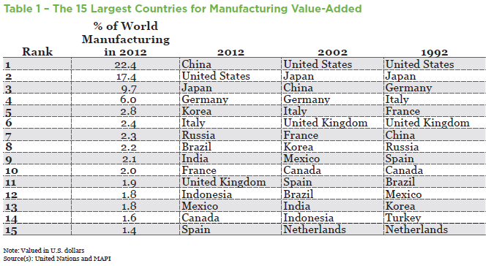

Slide 29
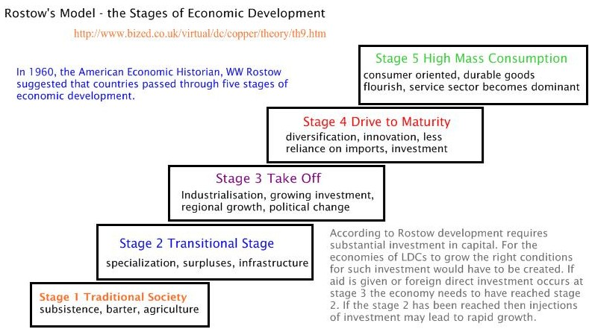

Slide 30
Is it fair for More Economically Developed countries to criticise China for the negative environmental aspects of its economic development?
Group Presentation (5 people)
Things to think about;
Maximum length – 5 minutes
No specified format
You can explore any aspect of the question
No scripts, laptops or phones
No reading from
the screen
50 word screen limit
Everyone should have an equal input & output

Slide 31
Is it right for More Developed Countries to blame China for the negative environmental aspects of its industrialisation?

Slide 32
How has industrialisation affected the world?
You are to research your segment of the argument on your GoogleDocs
You are to use this to create one third of a Padlet with your half of the class.
REMEMBER- DO NOT just list examples! ANSWER THE QUESTION!
Aim to have about two-three key ideas with examples & explanation (kudos for appropriate quotations that are cited).

Slide 33
How has industrialisation affected the world?
Economically?
-Division of labour
-Ability to buy cheap goods
Environmentally?
-Impact on biodiversity through farming of only a few crops & animals
-Pollution and climate change
On a human level?
-Life expectancy and standard of living in industrialised societies
-Social disruption of communities

